Slide 1
Chapter – 3
File Organization and Indexing

Slide 2
Outline
Disk Storage Devices
Files of Records
Operations on Files
Unordered Files
Ordered Files
Hashed Files
  Dynamic, Extendible and linear Hashing Techniques
RAID Technology

Slide 3
Introduction
Databases are stored physically as files of records, which are typically stored on magnetic disks
The collection of data that makes up a computerized database must be stored physically on some computer storage medium
DBMS software can then retrieve, update, and process this data as needed
Two main categories of storage medium
  Primary storage
  Secondary and tertiary storage

Slide 4
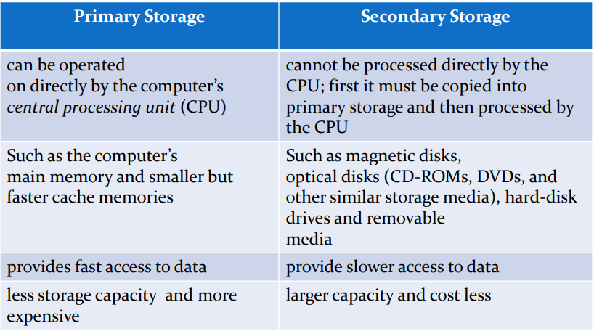
Primary vs Secondary Storage

Slide 5
Storage Hierarchy
Volatile
$$
Cache
Primary storage
Memory
unit price
Secondary storage
Flash Memory
Magnetic Disk
Non-volatile
speed
Tertiary storage
Optical Disk
Magnetic Tape

Slide 6
Storage Hierarchy
At the primary storage level
Cache memory
  Cache memory is typically used by the CPU to speed up execution of program instructions using techniques such as prefetching and pipelining
  It stores the segments of program that are frequently accessed by the processor
Main memory
  Provides the main work area for the CPU for keeping program instructions and data
  It is less expensive than cache memory and therefore larger in size
  The drawback is its volatility and lower speed compared with cache memory

Slide 7
Storage Hierarchy
At the secondary and tertiary storage level
The hierarchy includes magnetic disks, as well as mass storage in the form of CD-ROM (Compact Disk–Read-Only Memory) and DVD (Digital Video Disk or Digital Versatile Disk) devices, and finally tapes at the least expensive end of the hierarchy
The storage capacity is measured in kilobytes (Kbyte or 1000 bytes), megabytes (MB or 1 million bytes), gigabytes (GB or 1 billion bytes), and even terabytes (1000 GB)
The word petabyte is now becoming relevant in the context of very large repositories of data
Magnetic tapes are used for archiving and backup storage of data

Slide 8
Storage of Databases
DBMS stores information on (‘hard’) disks
This has major implications for DBMS design!
  – READ: transfer data from disk to main memory (RAM)
  – WRITE: transfer data from RAM to disk
  – Both are high-cost operations, relative to in memory operations, so must be planned carefully!
Why not store everything in main memory?
  Costs too much
  Main memory is volatile. We want data to be saved between runs
Typical storage hierarchy
  Main memory (RAM) for currently used data
  Disk for the main database
  Tapes for archiving older versions of the data

Slide 9
Secondary Storage Devices
Magnetic disks are used for storing large amounts of data
The most basic unit of data on the disk is a single bit of information. To code information, bits are grouped into bytes
Capacity of a disk is the number of bytes it can store, which is usually very large
Preferred secondary storage device for high storage capacity and low cost.
Data stored as magnetized areas on magnetic disk surfaces.
A disk pack contains several magnetic disks connected to a rotating spindle.
Disks are divided into concentric circular tracks on each disk surface
  Track capacities vary typically from 4 to 50 Kbytes or more

Slide 10
Disk Storage Devices
A track is divided into smaller blocks or sectors
  because it usually contains a large amount of information
The division of a track into sectors is hard-coded on the disk surface and cannot be changed
  One type of sector organization calls a portion of a track that subtends a fixed angle at the center as a sector
A track is divided into blocks
  The block size B is fixed for each system
    Typical block sizes range from B=512 bytes to B=4096 bytes
  Whole blocks are transferred between disk and main memory for processing

Slide 11
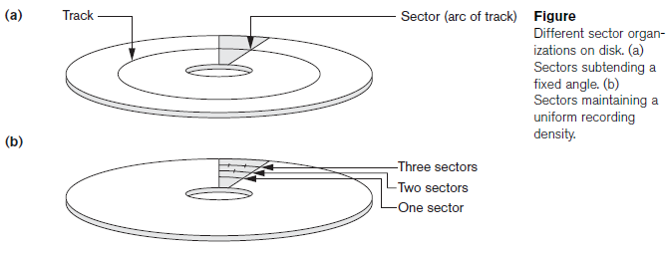
Disk Storage Devices

Slide 12
Disk Storage Devices
A read-write head moves to the track that contains the block to be transferred
  Disk rotation moves the block under the read-write head for reading or writing
A physical disk block (hardware) address consists of
  a cylinder number (imaginary collection of tracks of same radius from all recorded surfaces)
  the track number or surface number (within the cylinder) and
  block number (within track)
Time to access (read/write) a disk block
  Seek time (moving arms to position disk head on track)
  Rotational delay or latency (waiting for block to rotate under head)
  Transfer time (actually moving data to/from disk surface)
Locating data on a disk is a major bottleneck – need efficient techniques to do this

Slide 13
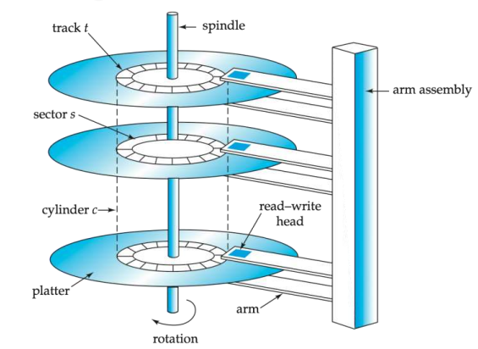
Disk Storage Devices
Figure
(a) A single-sided disk with read/write hardware
(b) A disk pack with read/write hardware

Slide 14
Components of a Disk
The platters spin (say, 90rps)
The arm assembly is moved in or out to position a head on a desired track
Read-write head
  Positioned very close to the platter surface (almost touching it)
  Reads or writes magnetically encoded information
  Only one head reads/writes at any one time
Surface of platter divided into circular tracks

Slide 15
Physical Characteristics of Disks
Track
  an information storage circle on the surface of a disk.
  Over 16,000 tracks per platter
  each track can store between 4KB and 50KB of data.
  Each track is divided into sectors.
  Tracks under heads make a cylinder (imaginary!)
Cylinder
  the tracks with the same diameter on all surfaces of a disk pack.
  Cylinder i consists of i-th track of all the platters
Sector
  a part of a track with fixed size
  separated by fixed-size interblock gaps
  Typical sectors per track
    200 (on inner tracks) to 400 (on outer tracks)

Slide 16
Pages and Blocks
Data files decomposed into pages (blocks)
  fixed size piece of contiguous information in the file
  sizes range from 512 bytes to several kilobytes
Block is the smallest unit for transferring data between the main memory and the disk
Address of a page (block)
  (cylinder#, track# (within cylinder), sector# (within track)

Slide 17
Pages and Blocks
Track
Gap
Sector
...
One track
1
2
3
4

Slide 18
Page I/O
Page I/O --- one page I/O is the cost (or time needed) to transfer one page of data between the memory and the disk.
The cost of a (random) page I/O =
  seek time + rotational delay + block transfer time
Seek time
  time needed to position read/write head on correct track.
Rotational delay (latency)
  time needed to rotate the beginning of page under read/write head
Block transfer time
  time needed to transfer data in the page/block

Slide 19
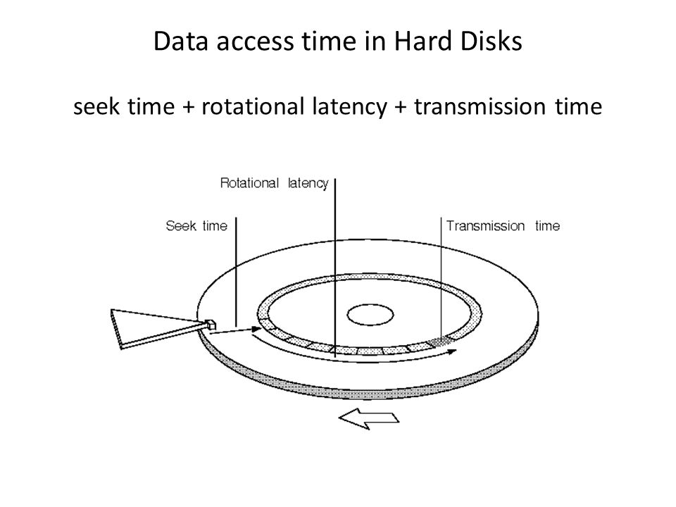

Slide 20
Magnetic Tape Storage Devices
Disks are random access secondary storage devices because an arbitrary disk block may be accessed at random once we specify its address
Magnetic tapes are sequential access devices; to access the nth block on tape, first we must scan the preceding n–1 blocks
Data is stored on reels of high-capacity magnetic tape, somewhat similar to audiotapes or videotapes
A read/write head is used to read or write data on tape.
Data records on tape are also stored in blocks—although the blocks may be substantially larger than those for disks
Tapes serve a very important function-backing up the database One reason for backup is to keep copies of disk files in case the data is lost due to a disk crash

Slide 21
Buffering of Blocks
When several blocks need to be transferred from disk to main memory and all the block addresses are known, several buffers can be reserved in main memory to speed up the transfer
While one buffer is being read or written, the CPU can process data in the other buffer because an independent disk I/O processor (controller) exists that, once started, can proceed to transfer a data block between memory and disk independent of and in parallel to CPU processing
Double buffering can be used to speed up the transfer of contiguous disk blocks

Slide 22
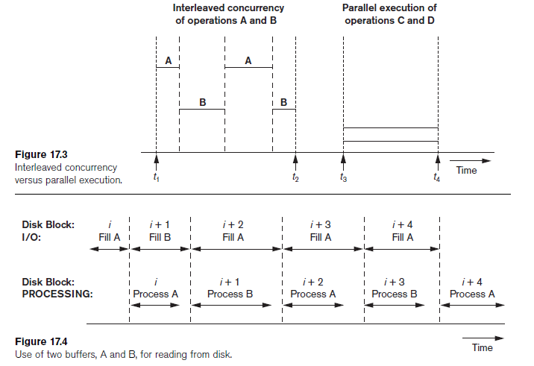
Buffering of Blocks

Slide 23
Placing File Records on Disk
Records
Data is usually stored in the form of records
  Each record consists of a collection of related data values or items, where each value is formed of one or more bytes and corresponds to a particular field of the record
  Records usually describe entities and their attributes
  For example
    An EMPLOYEE record represents an employee entity, and each field value in the record specifies some attribute of that employee, such as Name, Birth_date, Salary, or Supervisor

Slide 24
Placing File Records on Disk
Record Types
A collection of field names and their corresponding data types constitutes a record type or record format definition.
A data type, associated with each field, specifies the types of values a field can take
For example, an EMPLOYEE record type may be defined—using the C programming language notation-as the following structure:
  struct employee {
  char name[30];
  char ssn[9];
  int salary;
  int job_code;
  char department[20]; } ;

Slide 25
Placing File Records on Disk
Files, Fixed-Length Records, and Variable-Length Records
File - sequence of records
Fixed-Length Records - If every record in the file has exactly the same size (in bytes)
Variable-length records - If different records in the file have different sizes
Reasons for having variable-length records
  The file records are of the same record type, but one or more of the fields are of varying size (variable-length fields). For example, the Name field of EMPLOYEE can be a variable-length field
  The file records are of the same record type, but one or more of the fields are optional; that is, they may have values for some but not all of the file records (optional fields).

Slide 26
File Organization
The database is stored as a collection of files
Each file is a sequence of records
A record is a sequence of fields
Records are stored on disk blocks
A file can have fixed-length records or variable-length records

Slide 27
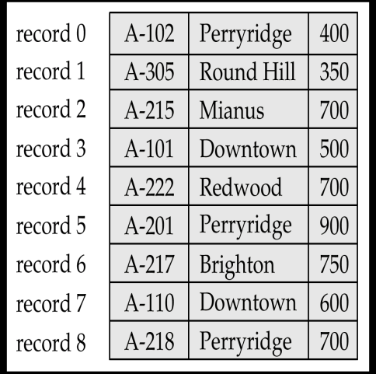
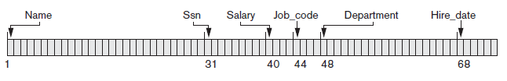
Placing File Records on Disk
Fixed Length Records
The fixed-length EMPLOYEE records in Figure have a record size of 71 bytes
Space is wasted when certain records do not have values for all the physical spaces provided in each record

Slide 28

Placing File Records on Disk
Variable-Length Records
For variable-length fields, each record has a value for each field, but we do not know the exact length of some field values.
To determine the bytes within a particular record that represent each field, we can use special separator characters (such as ? Or % or $) - which do not appear in any field value—to terminate variable-length fields

Slide 29
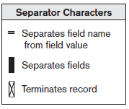
Placing File Records on Disk
Variable-Length Records
A file of records with optional fields can be formatted in different ways.
If the total number of fields for the record type is large, but the number of fields that actually appear in a typical record is small, we can include in each record a sequence of
<field-name, field-value> pairs
rather than just the field values
A more practical option – to assign a short field type code—say, an integer number-to each field and include in each record a sequence of <field-type, field-value> pairs rather than <field-name, field-value> pairs

Slide 30
Record Blocking and Spanned versus Unspanned Records
The records of a file must be allocated to disk blocks because a block is the unit of data transfer between disk and memory
When the block size > the record size, each block will contain numerous records, although some files may have unusually large records that cannot fit in one block
Suppose that the block size is B bytes
For a file of fixed-length records of size R bytes, with B ≥ R, we can fit bfr = ⎣B/R⎦ records per block, where the ⎣(x)⎦ (floor function) rounds down the number x to an integer
Bfr - called the blocking factor – number of records per block
In general, R may not divide B exactly, so we have some unused space in each block equal to B − (bfr * R) bytes

Slide 31
Blocking Factor
Blocking Factor (bfr) - the number of records that can fit into a single block.
  bfr = ⌊B/R⌋
    B : Block size in bytes
    R: Record size in bytes
Example:
  Record size R = 100 bytes
  Block Size B = 2,000 bytes
  Thus the blocking factor bfr = floor(2000/100) = 20
The number of blocks b needed to store a file of r records:
  b = floor(r / bfr)blocks

Slide 32
Record Blocking and Spanned versus Unspanned Records
Spanned organization of records
  To utilize this unused space, we can store part of a record on one block and the rest on another.
  A pointer at the end of the first block points to the block containing the remainder of the record in case it is not the next consecutive block on disk
  Spanned - records can span more than one block
  Whenever a record is larger than a block - use spanned organization
Unspanned organization of records
  Records are not allowed to cross block boundaries
  This is used with fixed-length records having B > R
Note: For variable-length records, either a spanned or an unspanned organization can be used

Slide 33
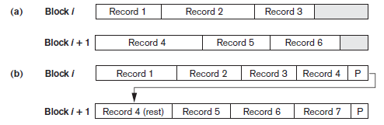
Record Blocking and Spanned versus Unspanned Records
For variable-length records using spanned organization, each block may store a different number of records.
In this case, the blocking factor bfr represents the average number of records per block for the file
bfr to calculate the number of blocks b needed for a file of r records
b = ⎡(r/bfr)⎤ blocks
where the ⎡(x)⎤ (ceiling function) rounds the value x up to the next integer
Figure : Types of record
organization.
(a) Unspanned.
(b) Spanned

Slide 34
Allocating File Blocks on Disk
Several standard techniques for allocating the blocks of a file on disk
  Contiguous allocation
  linked allocation
  Indexed allocation
Contiguous Allocation - requires that all blocks of a file be kept together contiguously
Performance is very fast, because reading successive blocks of the same file generally requires no movement of the disk heads, or at most one small step to the next adjacent cylinder
Problems can arise when files grow, or if the exact size of a file is unknown at creation time

Slide 35
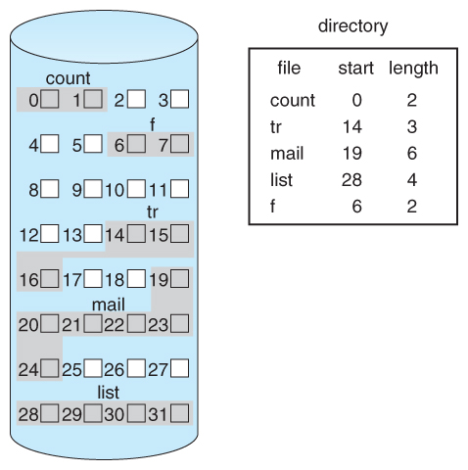
Allocating File Blocks on Disk
Contiguous Allocation

Slide 36
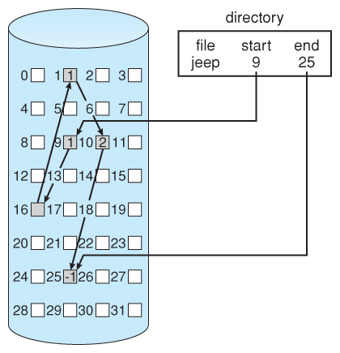
Allocating File Blocks on Disk
Linked Allocation
  Disk files can be stored as linked lists, with the expense of the storage space consumed by each link
  Linked allocation involves no wastage of space, does not require pre-known file sizes, and allows files to grow dynamically at any time
  A large number of seeks
  are needed to access every
  block individually

Slide 37
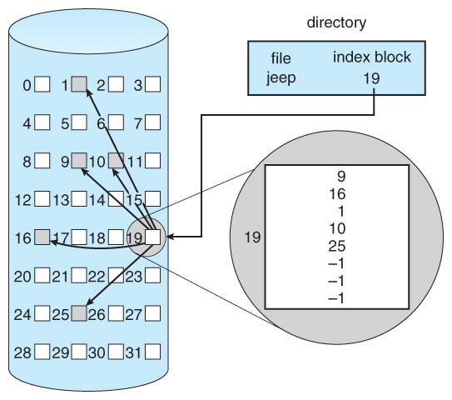
Allocating File Blocks on Disk
Indexed Allocation
  One or more index blocks contain pointers to the actual file blocks
  Supports direct access to the blocks occupied by the file and therefore provides fast access to the file blocks
The indexed allocation
would keep one entire block
(index block) for the
pointers (even for small files)
which is inefficient
in terms of memory utilization

Slide 38
Operations on Files
DBMS software programs, access records by using the following commands
OPEN - Prepares the file for reading or writing. Allocates appropriate buffers (typically at least two) to hold file blocks from disk, and retrieves the file header. Sets the file pointer to the beginning of the file
Reset - Sets the file pointer of an open file to the beginning of the file
Find (or Locate)- Searches for the first record that satisfies a search condition. Transfers the block containing that record into a main memory buffer (if it is not already there). The file pointer points to the record in the buffer and it becomes the current record

Slide 39
Operations on Files
Read (or Get) - Copies the current record from the buffer to a program variable in the user program. This command may also advance the current record pointer to the next record in the file, which may necessitate reading the next file block from disk
FindNext - Searches for the Searches for the next record in the file that satisfies the search condition. Transfers the block containing that record into a main memory buffer (if it is not already there)
Delete -Deletes the current record and (eventually) updates the file on disk to reflect the deletion
Modify-Modifies some field values for the current record and (eventually) updates the file on disk to reflect the modification
Insert - Inserts a new record in the file by locating the block where the record is to be inserted, transferring that block into a main memory buffer (if it is not already there), writing the record into the buffer, and (eventually) writing the buffer to disk to reflect the insertion
Close - Completes the file access by releasing the buffers and performing any other needed cleanup operations

Slide 40
Operations on Files
The preceding (except for Open and Close) are called record-at-a-time operations because each operation applies to a single record
In database systems, additional set-at-a-time higher-level operations may be applied to a file
FindAll. Locates all the records in the file that satisfy a search condition
Find (or Locate) n. Searches for the first record that satisfies a search condition and then continues to locate the next n – 1 records satisfying the same condition. Transfers the blocks containing the n records to the main memory buffer (if not already there)
FindOrdered. Retrieves all the records in the file in some specified order.
Reorganize. Starts the reorganization process. Some file organizations require periodic reorganization. An example is to reorder the file records by sorting them on a specified field

Slide 41
File Organization Vs Access Method
File organization
  Refers to the organization of the data of a file into records, blocks, and access structures; this includes the way records and blocks are placed on the storage medium and interlinked
Access method
  On the other hand, provides a group of operations that can be applied to a file

Slide 42
Methods for Organizing
Records of a File on Disk
  Heap file
  Sorted file
  Hash file
  RAID

Slide 43
Heap Files
Files of Unordered Records (Heap Files)
  Also called a heap or a pile file
  New records are inserted at the end of the file
    Record insertion is quite efficient
  A linear search through the file records is necessary to search for a record
    This requires reading and searching half the file blocks on the average, and is hence quite expensive
    For a file of b blocks, this requires searching (b/2) blocks, on average. If no records or several records satisfy the search condition, the program must read and search all b blocks in the file
  Reading the records in order of a particular field requires sorting the file records
  This organization is often used with additional access paths, such as the secondary indexes

Slide 44
Heap Files
  To delete a record, a program must first find its block, copy the block into a buffer, delete the record from the buffer, and finally rewrite the block back to the disk. This leaves unused space in the disk block.
  Deleting a large number of records in this way results in wasted storage space.
  Another technique used for record deletion is to have an extra byte or bit, called a deletion marker, stored with each record
  spanned or unspanned organization can be use and it may be used with either fixed-length or variable-length records
  Modifying a variable- length record may require deleting the old record and inserting a modified record because the modified record may not fit in its old space on disk

Slide 45
Heap File Organization
Records are placed in the file in the order in which they are inserted. Such an organization is called a heap file
  Insertion is at the end
    takes constant time O(1) (very efficient)
  Searching
    requires a linear search (expensive)
  Deleting
    requires a search, then delete
  Select, Update and Delete
    take b/2 time (linear time) in average
    b is the number of blocks

Slide 46
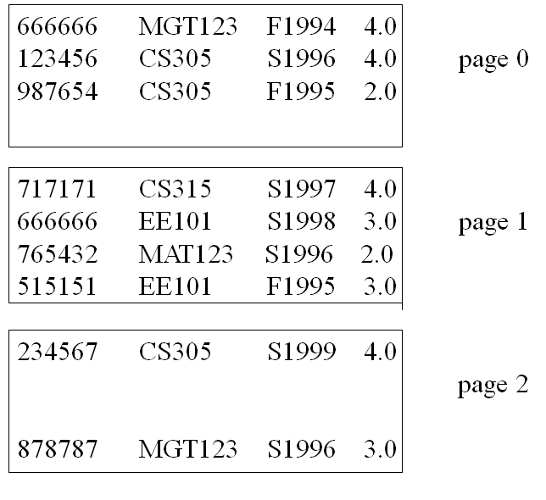
File Stored as a Heap File

Slide 47
Sorted Files
Files of Ordered Records (Sorted Files)
  We can physically order the records of a file on disk based on the values of one of their fields—called the ordering field
  This leads to an ordered or sequential file
  If the ordering field is also a key field of the file—a field guaranteed to have a unique value in each record
Some advantages ordered files over unordered files
  Reading the records in order of the ordering key values becomes extremely efficient because no sorting is required
  Finding the next record from the current one in order of the ordering key usually requires no additional block accesses because the next record is in the same block as the current o
  Using a search condition based on the value of an ordering key field results in faster access when the binary search technique is used

Slide 48
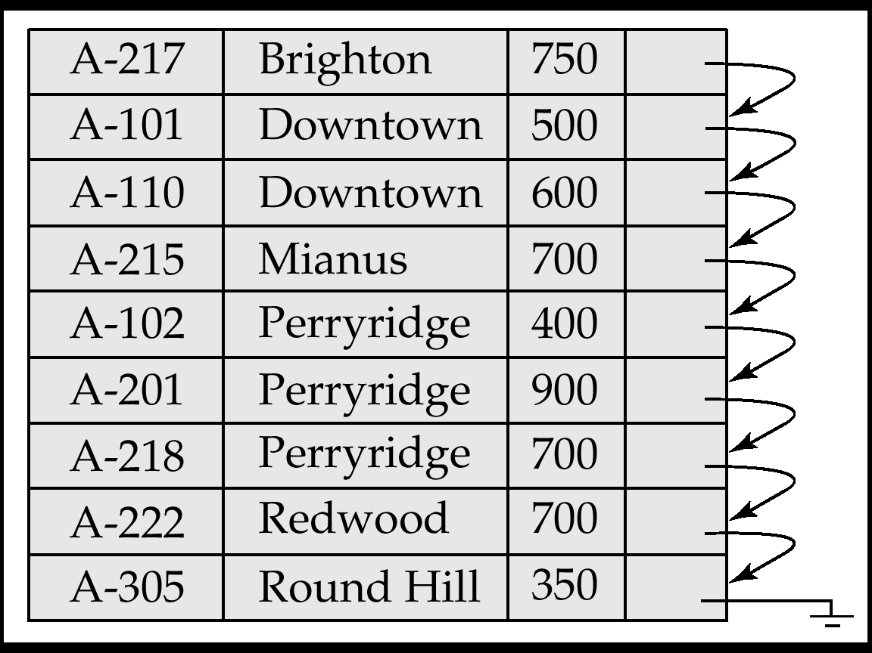
Sorted Files
Suppose that the file has b blocks numbered 1, 2, ..., b
The records are ordered by ascending value of their ordering key field
Searching for a record whose ordering key field value is K
Binary search usually accesses log₂(b) blocks, whether the record is found or not
  An improvement over linear searches, where, on the average, (b/2) blocks are accessed when the record is found and b blocks are accessed when the record is not found

Slide 49
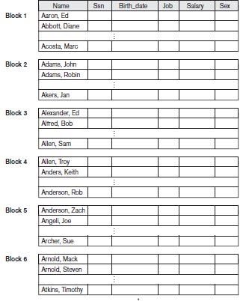
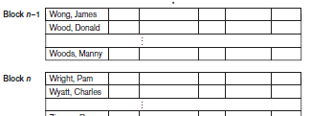
Sorted Files
Figure
Some blocks of an ordered
(sequential) file of EMPLOYEE
records with Name as the
ordering key field

Slide 50
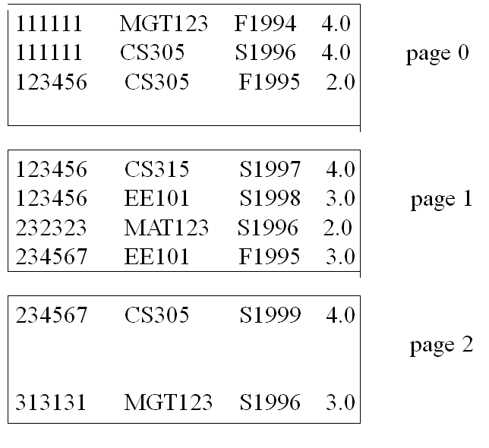
Sorted Files

Slide 51
Sorted Files
Inserting and deleting records are expensive operations for an ordered file because the records must remain physically ordered
Insert
  To insert a record, we must find its correct position in the file, based on its ordering field value, and then make space in the file to insert the record in that position.
  For a large file this can be very time consuming because, on the average, half the records of the file must be moved to make space for the new record
Delete
  For record deletion, the problem is less severe if deletion markers and periodic reorganization are used

Slide 52
Sorted Files
Modification
Modifying a field value of a record depends on two factors: the search condition to locate the record and the field to be modified
  Search Condition
  If the search condition involves the ordering key field, we can locate the record using a binary search; otherwise we must do a linear search
  Field to be modified
  A non-ordering field can be modified by changing the record and rewriting it in the same physical location on disk-assuming fixed-length records
  Modifying the ordering field means that the record can change its position in the file. This requires deletion of the old record followed by insertion of the modified record

Slide 53
Sequential File Organization
Insertion is expensive
  records must be inserted in the correct order
    locate the position where the record is to be inserted
    if there is free space insert there
    if no free space insert the record in an overflow block
    In either case, pointer chain must be updated
  Insert takes lg₂(b) plus the time to re-organize records
  b is the number of blocks
Deletion
  use pointer chains
Searching
  very efficient (Binary search)
  This requires lg₂(b) on the average

Slide 54
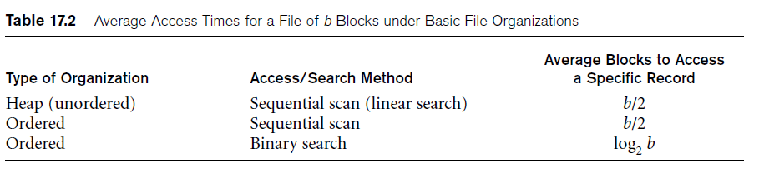
Sorted Files

Slide 55
Hash Files
Another type of primary file organization is based on hashing - provides very fast access to records under certain search conditions
The search condition must be an equality condition on a single field, called the hash field
In most cases, the hash field is also a key field of the file, in which case it is called the hash key
Idea - to provide a function h, called a hash function or randomizing function, which is applied to the hash field value of a record and yields the address of the disk block in which the record is stored
A search for the record within the block can be carried out in a main memory buffer. For most records, we need only a single-block access to retrieve that record

Slide 56
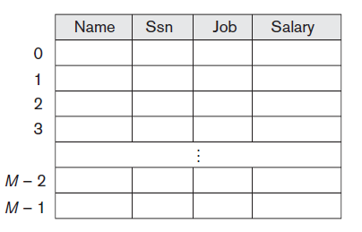
Hash Files
Internal Hashing
  For internal files, hashing is typically implemented as a hash table through the use of an array of records. Suppose that the array index range is from 0 to M – 1
  we have M slots whose addresses correspond to the array indexes.
  Choose a hash function that transforms the hash field value into an integer between 0 and M − 1.
  One common hash function is the h(K) = K mod M function - which returns the remainder of an integer hash field value K after division by M; this value is then used for the record address

Slide 57
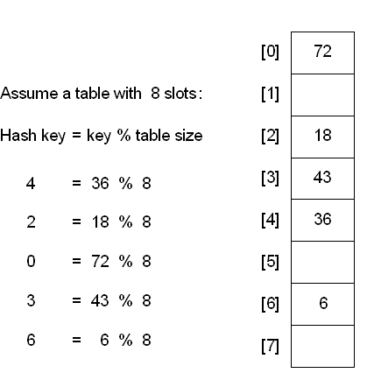
Hash Files

Slide 58
Hash Files
Other hashing functions can be used
  Folding
    Involves applying an arithmetic function such as addition or a logical function such as exclusive or to different portions of the hash field value to calculate the hash address
    For example, with an address space from 0 to 999 to store 1,000 keys, a 6-digit key 235469 may be folded and stored at the address: (235+964) mod 1000 = 199)
Another technique involves picking some digits of the hash field value
  For instance, the third, fifth, and eighth digits—to form the hash address 301-67-8923 a hash value of 172 by this hash function

Slide 59
Hash Files
Most hashing functions is that they do not guarantee that distinct values will hash to distinct addresses
Hash collision
  Occurs when the hash field value of a record that is being inserted hashes to an address that already contains a different record
  In this situation, we must insert the new record in some other position, since its hash address is occupied
  The process of finding another position is called collision resolution

Slide 60
Hash Files
Methods for collision resolution
  Open addressing
    Proceeding from the occupied position specified by the hash address, the program checks the subsequent positions in order until an unused (empty) position is found
  Chaining
    For this method, various overflow locations are kept, usually by extending the array with a number of overflow positions. Additionally, a pointer field is added to each record location.
    A collision is resolved by placing the new record in an unused overflow location and setting the pointer
  Multiple hashing
    The program applies a second hash function if the first results in a collision. If another collision results, the program uses open addressing or applies a third hash function and then uses open addressing if necessary

Slide 61
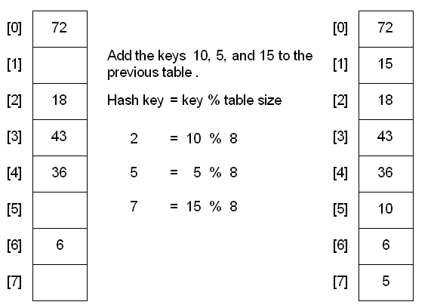
Hash Files
  Hash Collision - Open addressing

Slide 62
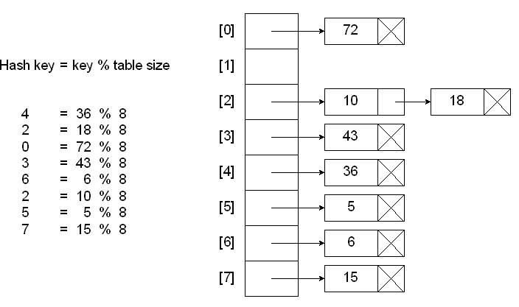
Hash Files
Hashing with Chains
When a collision occurs, elements with the same hash key will be chained together.
A chain is simply a linked list of all the elements with the same hash key.

Slide 63
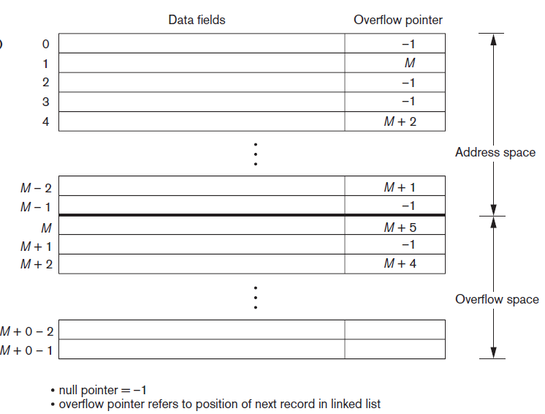
Hash Files
Figure : Collision resolution by chaining records

Slide 64
Hash Files
External Hashing for Disk Files
  Hashing for disk files is called external hashing
  The target address space is made of buckets, each of which holds multiple records.
  A bucket is either one disk block or a cluster of contiguous disk blocks.
  The hashing function maps a key into a relative bucket number, rather than assigning an absolute block address to the bucket.
  A table maintained in the file header converts the bucket number into the corresponding disk block address

Slide 65
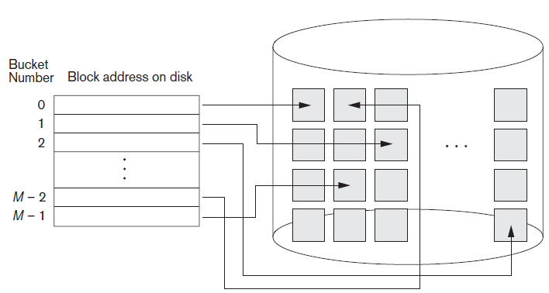
Hash Files
Figure: Matching bucket numbers to disk block addresses

Slide 66
Hash Files
Collision problem is less severe with buckets - as many records as will fit in a bucket can hash to the same bucket without causing problems
A variation of chaining in which a pointer is maintained in each bucket to a linked list of overflow records for the bucket
The pointers in the linked list should be record pointers, which include both a block address and a relative record position within the block
The hashing scheme described so far is called static hashing because a fixed number of buckets M is allocated.

Slide 67
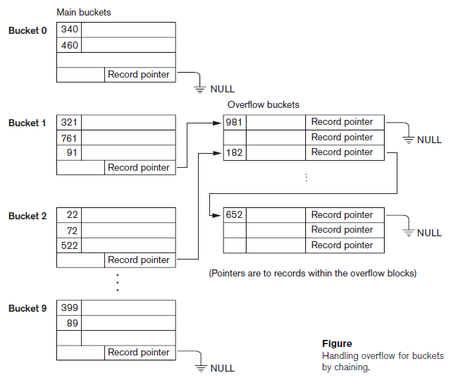
Hash Files

Slide 68
Hashing Techniques
The hashing scheme is called static hashing if a fixed number of buckets is allocated
Main disadvantage of static external hashing:
  The number of buckets must be chosen large enough that can handle large files. That is, it is difficult to expand or shrink the file dynamically.
Solutions to the above problem
  Dynamic hashing
  Extendible hashing
  Linear hashing

Slide 69
Hashing for Dynamic File Organization
Hashing for Dynamic File Organization
Dynamic Files
  Files where record insertions and deletion take place frequently
  The file keeps growing and also shrinking
Hashing for dynamic file organization
  Bucket numbers are integers
  The binary representation of bucket numbers
    Exploited cleverly to devise dynamic hashing schemes

Slide 70
Dynamic And Extendible Hashed Files
Dynamic and Extendible Hashing Techniques
  Hashing techniques are adapted to allow the dynamic growth and shrinking of the number of file records
  These techniques include the following: dynamic hashing, extendible hashing, and linear hashing
Both dynamic and extendible hashing use the binary representation of the hash value h(K) in order to access a directory
  In dynamic hashing, the directory is a binary tree
  In extendible hashing the directory is an array of size 2^{d} where d is called the global depth
    The value of d can be increased or decreased by one at a time, thus doubling or halving the number of entries in the directory array
    Doubling is needed if a bucket, whose local depth d is equal to the global depth d, overflows

Slide 71
Dynamic And Extendible Hashed Files
The directories can be stored on disk, and they expand or shrink dynamically
  Directory entries point to the disk blocks that contain the stored records
An insertion in a disk block that is full causes the block to split into two blocks and the records are redistributed among the two blocks
  The directory is updated appropriately
Dynamic and extendible hashing do not require an overflow area.
Linear hashing does require an overflow area but does not use a directory
  Blocks are split in linear order as the file expands

Slide 72
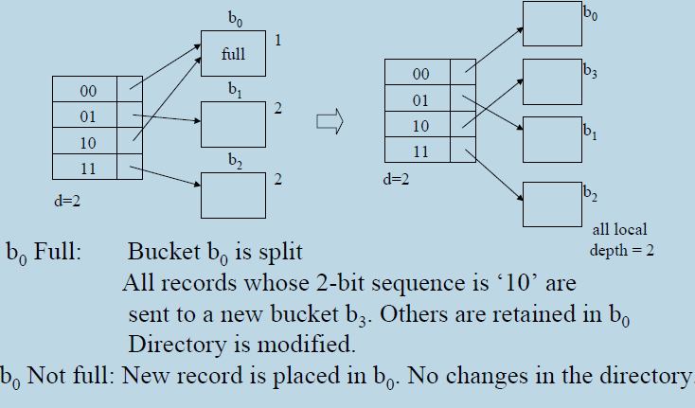
Insertion in Extendible Hashing Scheme
2 -bit sequence for the record to be inserted

Slide 73
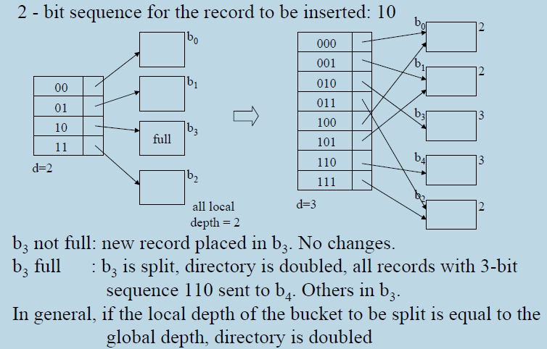
Insertion in Extendible Hashing Scheme

Slide 74
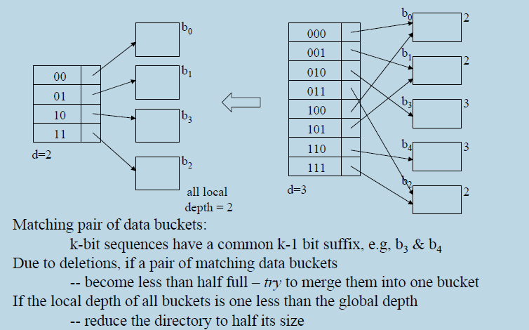
Deletion in Extendible Hashing Scheme

Slide 75
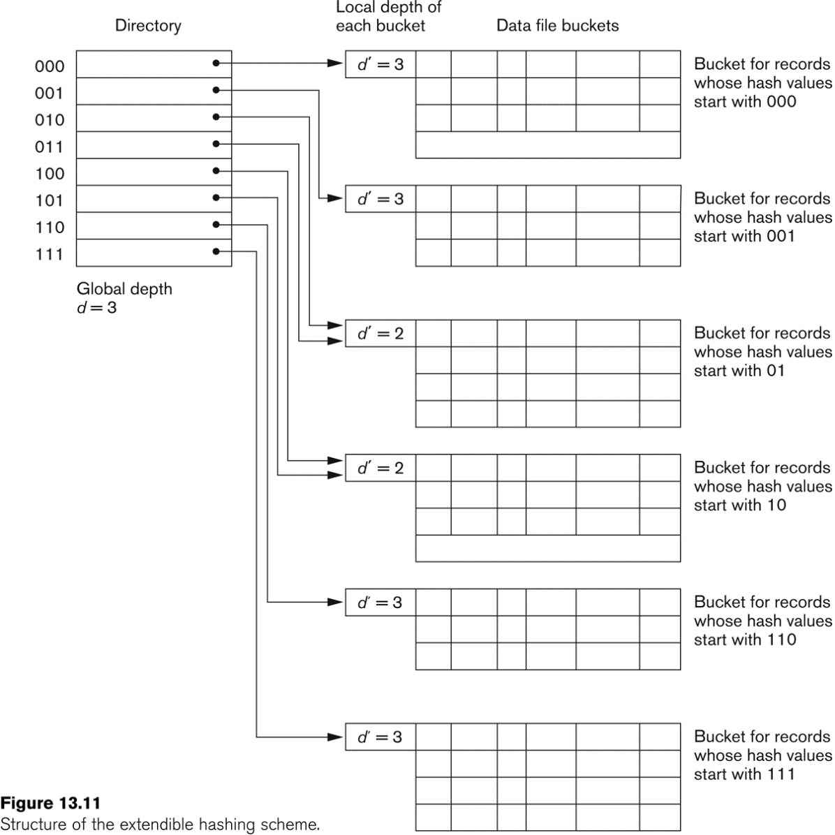
Extendible Hashing

Slide 76
Dynamic Hashing
A precursor to extendible hashing was dynamic hashing
The storage of records in buckets for dynamic hashing is somewhat similar to extendible hashing.
The major difference is in the organization of the directory
Dynamic hashing maintains a tree-structured directory with two types of nodes:
  Internal nodes that have two pointers—the left pointer corresponding to the 0 bit (in the hashed address) and a right pointer corresponding to the 1 bit
  Leaf nodes—these hold a pointer to the actual bucket with records

Slide 77
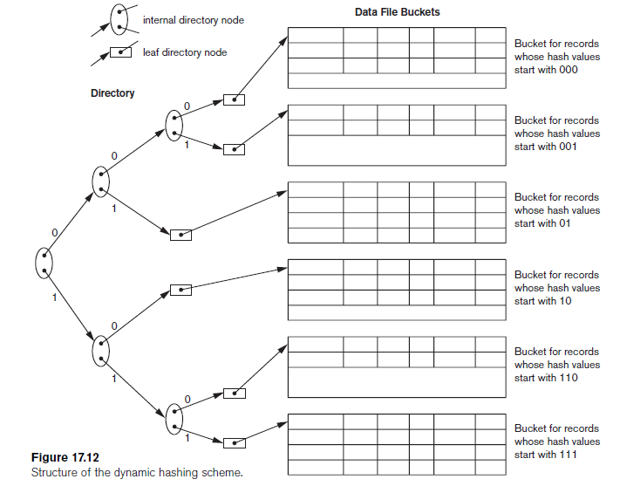
Dynamic Hashing

Slide 78
Linear Hashing
Idea - is to allow a hash file to expand and shrink its number of buckets dynamically without needing a directory
Starts with M buckets numbered 0, 1, ..., M − 1 and uses the mod hash function h(K) = K mod M; this hash function is called the initial hash function h_{i}.
Overflow because of collisions is still needed and can be handled by maintaining individual overflow chains for each bucket
When a collision leads to an overflow record in any file bucket, the first bucket in the file - bucket 0-is split into two buckets:
  The original bucket 0 and a new bucket M at the end of the file.
  The records originally in bucket 0 are distributed between the two buckets based on a different hashing function h_{i}+1(K) = K mod 2M

Slide 79
Linear Hashing
A key property of the two hash functions h_{i} and h_{i+1} is that any records that hashed to bucket 0 based on hi will hash to either bucket 0 or bucket M based on h_{i+1}; this is necessary for linear hashing to work
As further collisions lead to overflow records, additional buckets are split in the linear order 1, 2, 3, .... If enough overflows occur, all the original file buckets 0, 1, ..., M− 1 will have been split, so the file now has 2M instead of M buckets, and all buckets use the hash function h_{i+1}.
Hence, the records in overflow are eventually redistributed into regular buckets, using the function h_{i+1} via a delayed split of their buckets

Slide 80
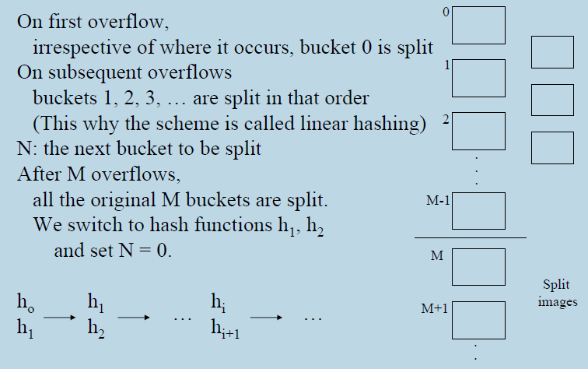
Insertion

Slide 81
Linear Hashing
Advantages
  Directory is not needed
  Simple to implement
Reference - Example for Linear hashing
http://queper.in/drupal/blogs/dbsys/linear_hashing

Slide 82
Parallelizing Disk Access
Using RAID Technology
Secondary storage technology must take steps to keep up in performance and reliability with processor technology
A major advance in secondary storage technology is represented by the development of RAID, which originally stood for Redundant Arrays of Inexpensive Disks
The main goal of RAID is to even out the widely different rates of performance improvement of disks against those in memory and microprocessors

Slide 83
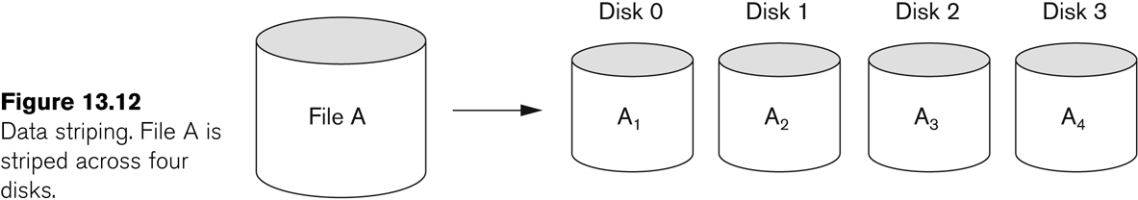
RAID Technology
A natural solution is a large array of small independent (inexpensive) disks acting as a single higher-performance logical disk
A concept called data striping is used, which utilizes parallelism to improve disk performance
Data striping distributes data transparently over multiple disks to make them appear as a single large, fast disk

Slide 84
RAID Technology
Provides
  Increased performance
  Fault Tolerance
  Redundancy
  RAID Levels
    Level 0
    Level 1
    Level 2
    Level 3
    Level 4
    Level 5
    Level 6
    Level 10 (1+0)

Slide 85
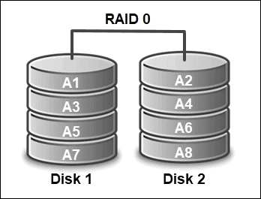
RAID Technology
RAID Level 0
  Minimum number of drives required - 2
  A RAID Level 0 system uses data striping - dividing data evenly across two or more storage devices
  No redundant information is maintained
  Purpose - speed up performance as organizing data in such a way allows faster reading and writing of files
  Not fault-tolerant should not be used for critical data
  Simple and easy to implement

Slide 86
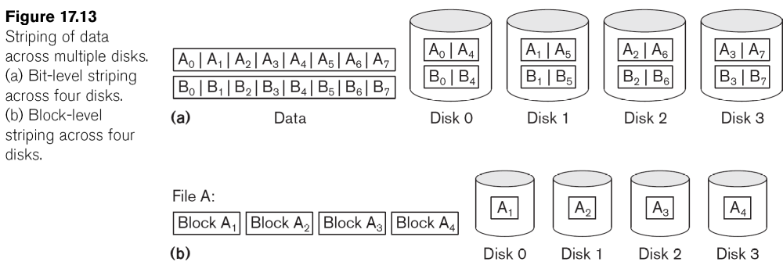
RAID Technology
Data striping means breaking up contiguous data that would normally go on a single disk
The data is distributed to many disks, either by byte (a) or by block (b)

Slide 87
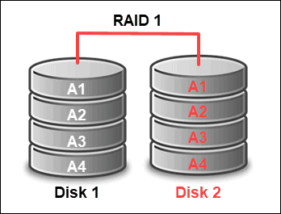
RAID Technology
RAID Level 1 – minimum no. of drives required - 2
Disk Mirroring - is fault-tolerant as it duplicates data by simultaneously writing on two storage devices
Therefore, each disk has an exact copy on another disk
RAID 1 - ensures protection against data loss. If a problem arises with one disk, the copy provides the data needed
Writing takes more time as it only uses the capacity of one disk and has to operate twice
Disadvantages
Uses only half of the storage capacity
More expensive

Slide 88
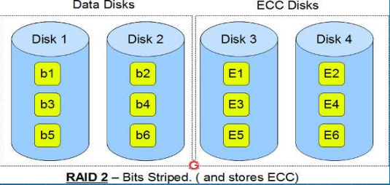
RAID Technology
RAID Level 2
Bit-level striping means that the file is broken into “bit-sized pieces”.
It uses a Hamming code for error correction
Theoretical performance is very high, but it would be so expensive to implement

Slide 89
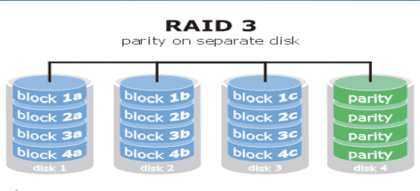
RAID Technology
RAID Level 3
Requires a minimum of 3 drives to implement
Byte-level striping means that the file is broken into "byte sized pieces“.
Written in parallel on two or more drives
An additional drive stores parity information

Slide 90
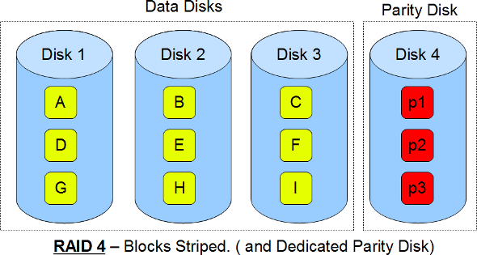
RAID Technology
RAID Level 4
Minimum nos. of drives required : 3 (2 disks for data and 1 for parity)
Level 4 provides block-level striping (like Level 0) with a parity disk
If a data disk fails, the parity data is used to create a replacement disk

Slide 91
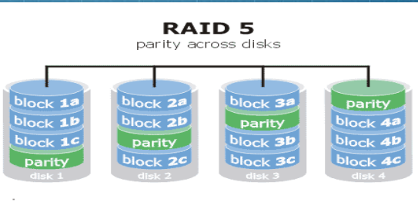
RAID Technology
RAID Level 5
  Most common secure RAID level
  Instead of a dedicated parity disk, parity information is spread across all the drives

Slide 92
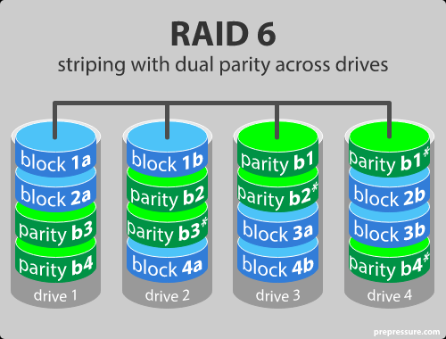
RAID Technology
RAID Level 6
The parity data are written to two drives
The chances that two drives break down at exactly the same moment are of course very small
Advantages
  Read data transactions are very fast
  RAID 6 is more secure than RAID 5

Slide 93
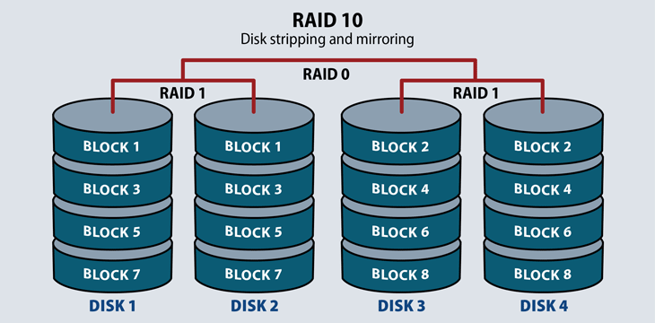
RAID Technology
RAID level 10 – combining RAID 1 & RAID 0
Combine the advantages of RAID 0 and RAID 1 in one single system
Provides security by mirroring all data on secondary drives while using striping across each set of drives to speed up data transfers
Advantage
  If something goes wrong with one of the disks, the rebuild time is very fast since all that is needed is copying all the data from the surviving mirror to a new drive
Disadvantage
  Half of the storage capacity goes to mirroring. expensive way to have redundancy.

